Slide 1
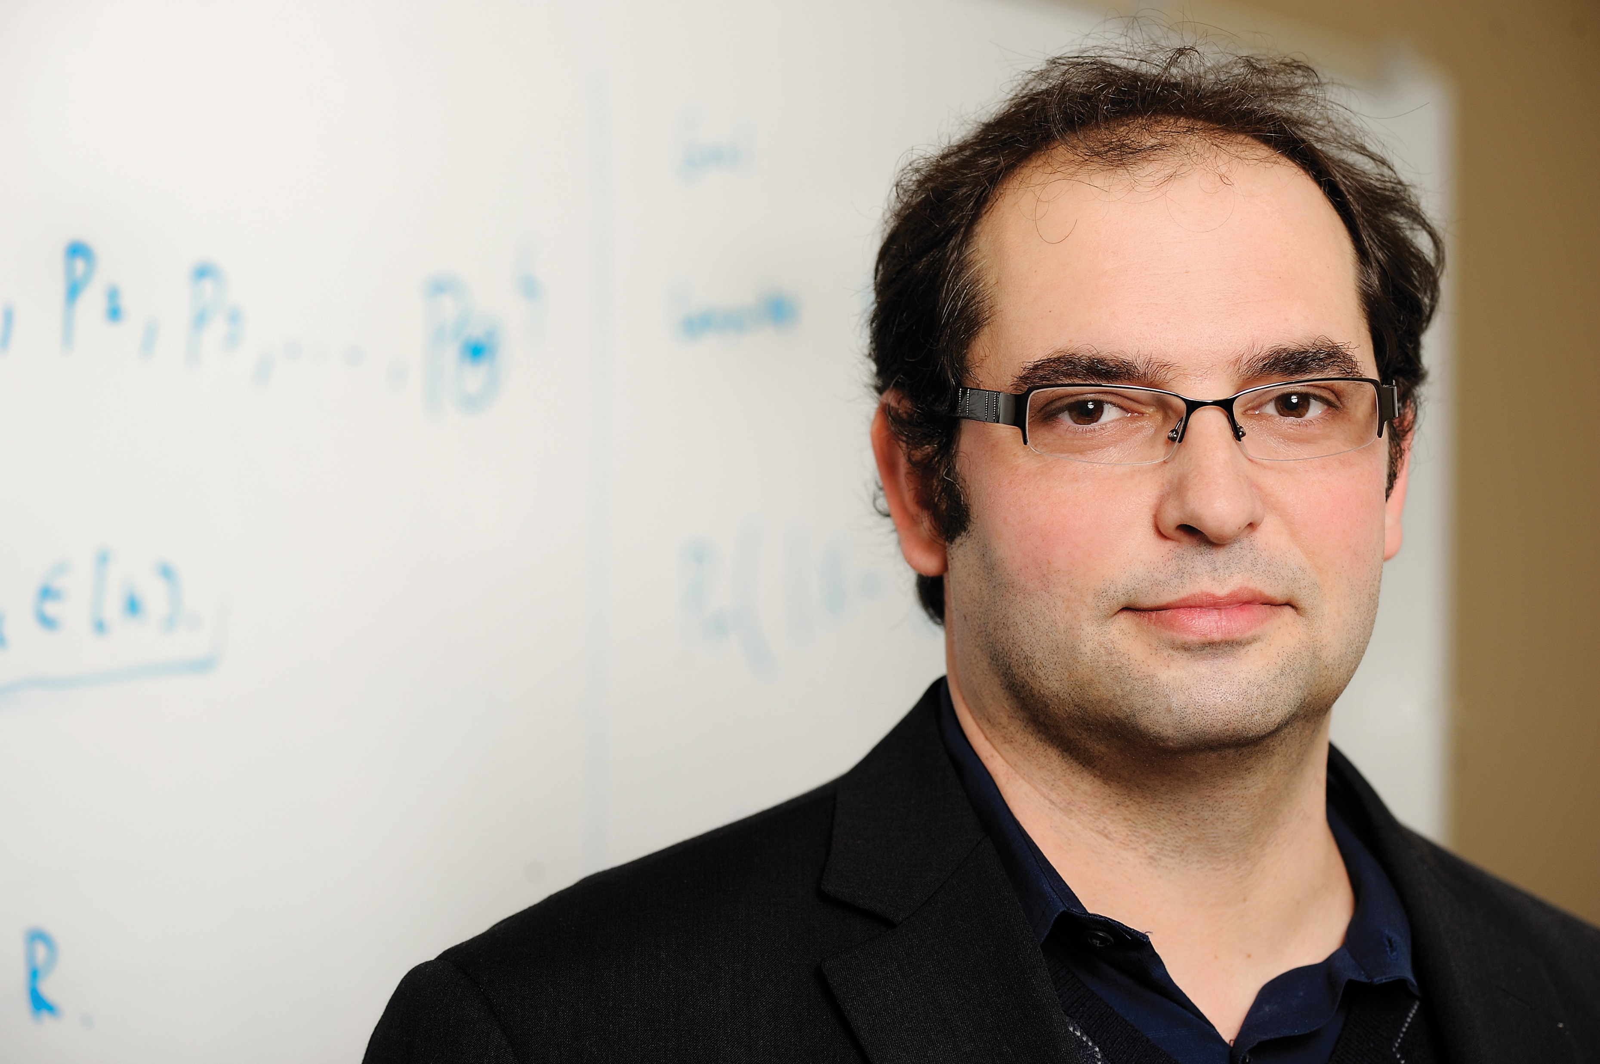


Private Data Stream Analysis for Universal Symmetric Norm Estimation
Vladimir Braverman
Joel Manning
Steven Wu
Samson Zhou

Slide 2
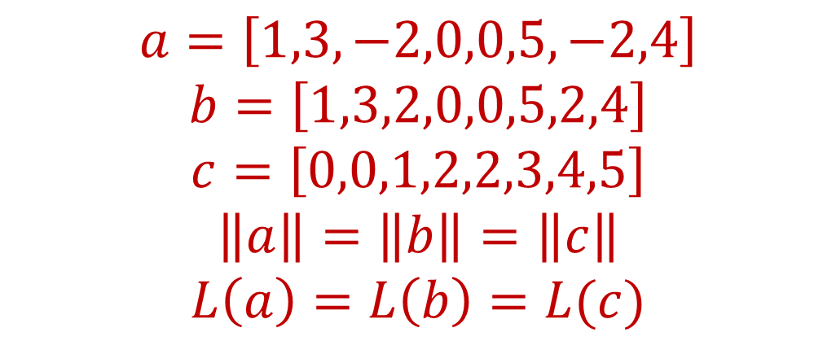
Symmetric Norms
A norm is symmetric if it is invariant under permutations and sign flips on an input frequency vector
$$a=\left[1,3,−2,0,0,5,−2,4\right]$$
$$b=\left[1,3,2,0,0,5,2,4\right]$$
$$c=\left[0,0,1,2,2,3,4,5\right]$$
$$\left\|a\right\|=\left\|b\right\|=\left\|c\right\|$$
$$L\left(a\right)=L\left(b\right)=L(c)$$
Notes:
A symmetric norm is any norm that is the same when the underlying coordinates of the vector are permuted or the signs of the vectors change. Note that a and b only differ in sign changes, so a symmetric norm would satisfy ||a||=||b||. We also have that c can be acquired from permuting the coordinates of b, so ||b||=||c||=||a|| for a symmetric norm. We’ll use L to denote a symmetric norm, so that L(a)=L(b)=L(c)

Slide 3
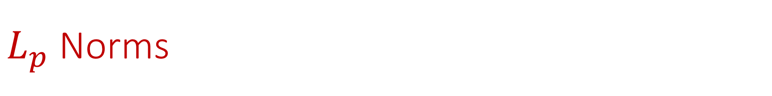

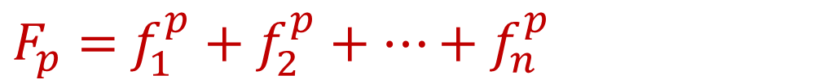
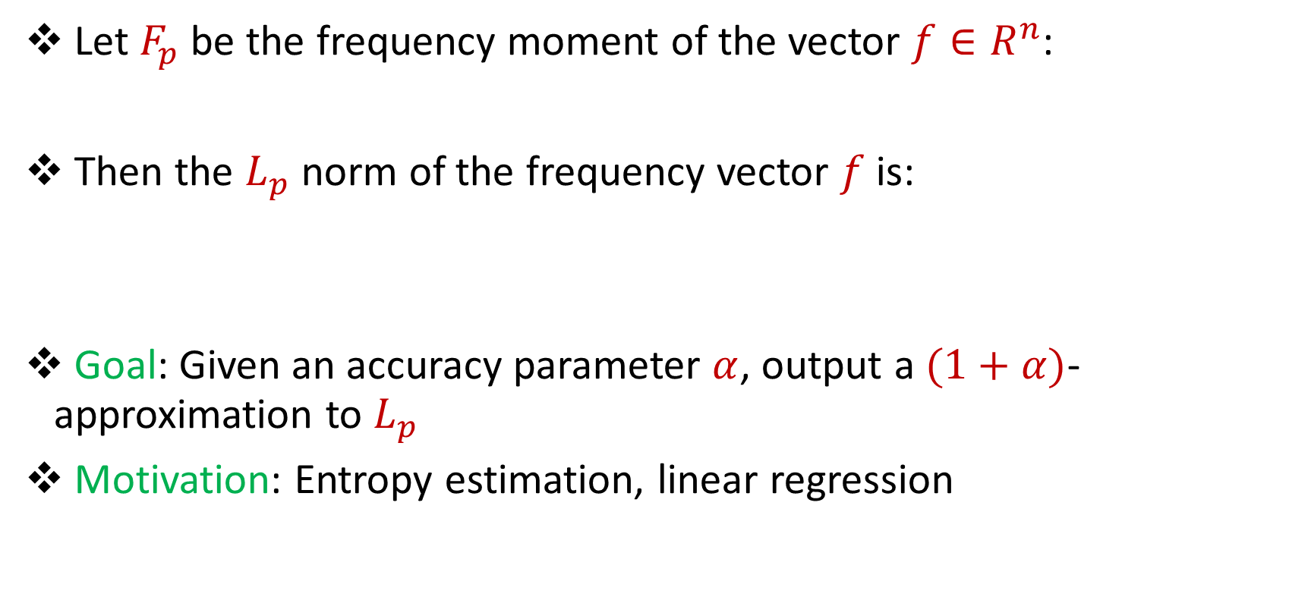
$L_{p}$ Norms
Let $F_{p}$ be the frequency moment of the vector $f∈R^{n}$:
Then the $L_{p}$ norm of the frequency vector $f$ is:
Goal: Given an accuracy parameter $α$, output a $(1+α)$-approximation to $L_{p}$
Motivation: Entropy estimation, linear regression
$F_{p}=$ $f_{1}^{p}+f_{2}^{p}+…+f_{n}^{p}$
$$L_{p}\left(f\right)={\left(F_{p}\left(f\right)\right)}^{1/p}$$
Notes:
One example of a symmetric norm is the popular family of L_p norms. If we have an n-dimensional vector f, we define the p-th frequency moment of f to the sum of the p-th powers of the n coordinates of f and the L_p norm of f is the p-th root of the p-th frequency moment. Often, f is itself noisy, so it suffices to approximate the norm of f, say to a (1+alpha)-factor. This is often used in things like entropy estimation, which can be approximated using a linear combination of a small number of L_p norms for p in (0,2]. It’s often used in things like linear regression to estimate the loss of fitting a dataset with a given model and thus used to select the best model.

Slide 4
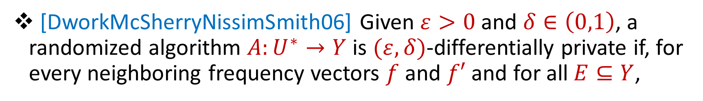
Differential Privacy
[DworkMcSherryNissimSmith06] Given $ε>0$and $δ∈\left(0,1\right)$, a randomized algorithm $A:U^{∗}→Y$ is $(ε,δ)$-differentially private if, for every neighboring frequency vectors $f$ and $f′$ and for all $E⊆Y$,
$$Pr\left[A\left(f\right)∈E\right]≤e^{ε}Pr\left[A\left(f^{′}\right)∈E\right]+δ$$
Notes:
However, often the dataset can be sensitive information, so we would like to protect the dataset. Differential privacy has emerged as a standard notion for measuring privacy loss while sharing information about a group of individuals. Intuitively, it offers plausible deniability of an individual’s participation in a study by showing that the same output could have been achieved by a neighboring dataset that does not include the individual.

Slide 5
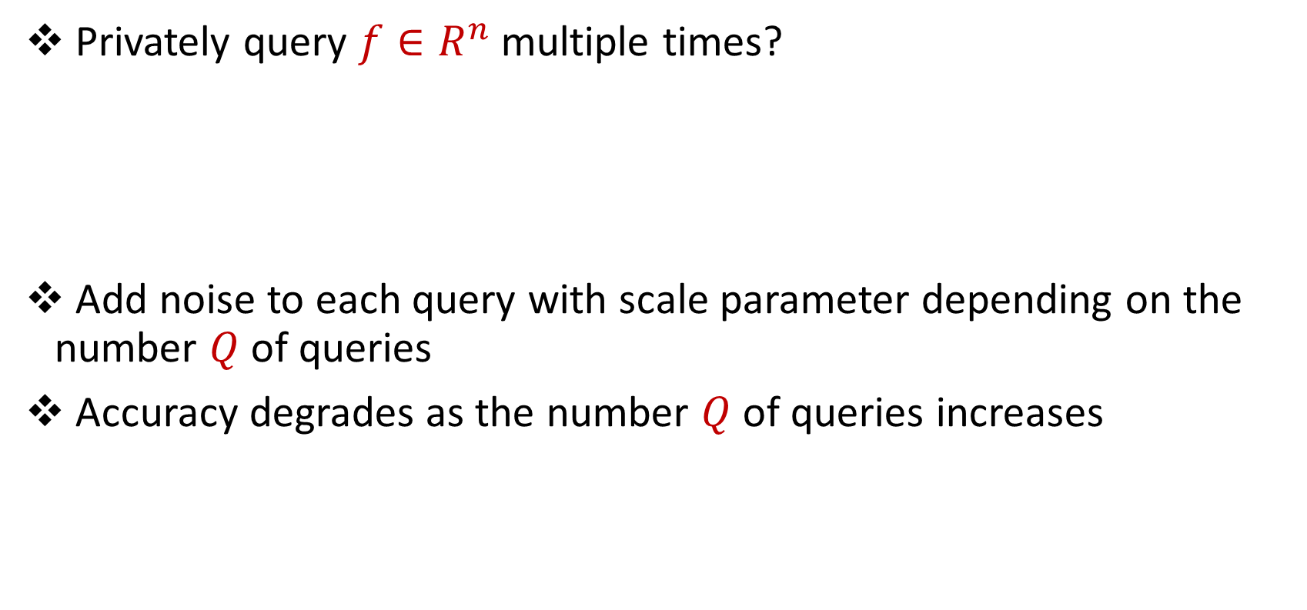
Multiple Privately Queries
Privately query $f∈R^{n}$ multiple times?
Add noise to each query with scale parameter depending on the number $Q$of queries
Accuracy degrades as the number $Q$of queries increases
Notes:
Unfortunately, as we query the same dataset multiple times, the privacy loss generally degrades. The typical way to handle this is through composition techniques, which require lower privacy loss for each interaction with the dataset, and thus requires adding more noise to each query. In other words, as the number of Q of total queries to the dataset increases, the added noises generally increases as well. Thus the overall accuracy of our queries generally degrades as the total number Q of queries increases.

Slide 6
Can we answer multiple queries without sacrificing accuracy?
“Beating advanced composition”
“Avoid privacy analysis per algorithm”
Notes:
In this work, we ask whether we can answer multiple queries about a vector’s norm without sacrificing accuracy. For example, to approximate the entropy of a dataset, we may ask for the L_p norm of the dataset for several different values of p. We would like to do this without blowing up the error on each query. This question can also be viewed in the lens of asking whether we can beat advanced composition over a number of queries, or whether we can avoid privacy analysis per query.

Slide 7
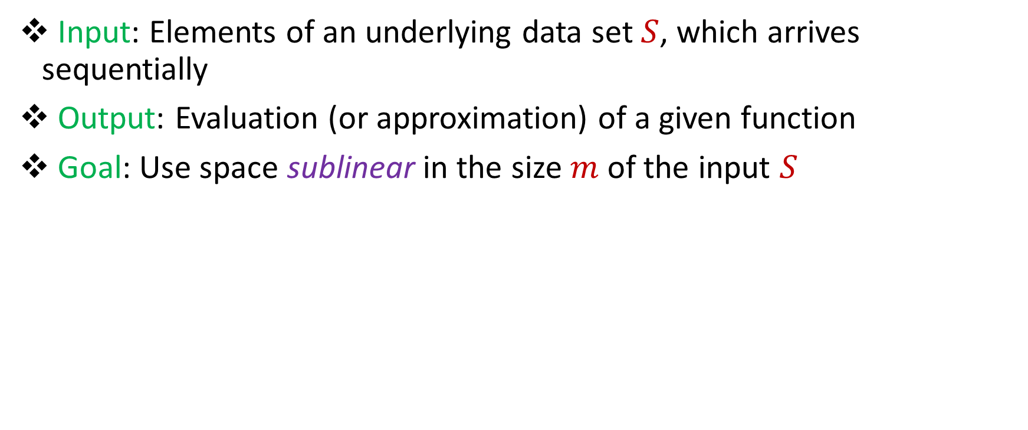
Streaming Model
Input: Elements of an underlying data set $S$, which arrives sequentially
Output: Evaluation (or approximation) of a given function
Goal: Use space sublinear in the size $m$of the input $S$
Notes:
Though this question is well-defined in general, it may be helpful to borrow a number of recent results on symmetric norms in the streaming model, so for the rest of the talk, we’ll just work in the streaming model. In this setting, the updates to the frequency vector will arrive one at a time, and the goal is to evaluate or approximate a given function using space that is sublinear in the input.

Slide 8
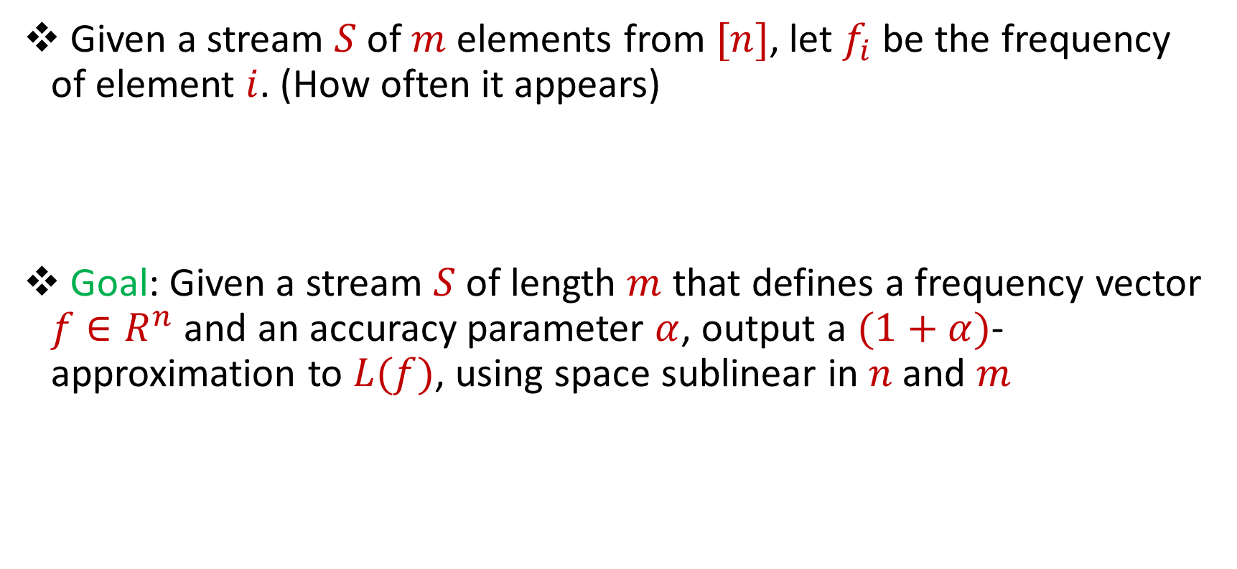
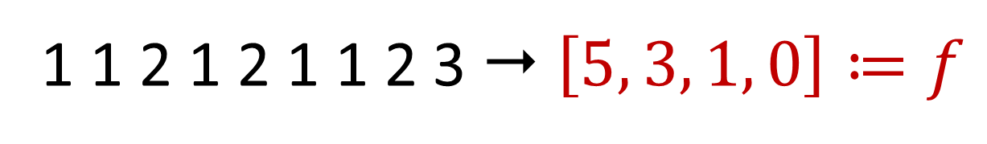
Symmetric Norms in the Streaming Model
Given a stream $S$ of $m$ elements from $[n]$, let $f_{i}$ be the frequency of element $i$. (How often it appears)
Goal: Given a stream $S$ of length $m$ that defines a frequency vector $f∈R^{n}$ and an accuracy parameter $α$, output a $(1+α)$-approximation to $L(f)$, using space sublinear in $n$and $m$
1 1 2 1 2 1 1 2 3  $\left[5, 3, 1, 0\right]≔f$
Notes:
We’ll work in the insertion-only model, so each element in the stream will increment the corresponding coordinate in the frequency vector. For example, the data stream on the bottom left of your screen will induce the frequency vector [5, 3, 1, 0] because the item 1 appears 5 times in the stream, the item 2 appears 3 times in the stream, the item 3 appears once, and the item 4 never appears. In the streaming model, the goal would be to output a (1+alpha)-approximation to a symmetric norm query using space that is sublinear in both the data stream and the size of the frequency vector.

Slide 9
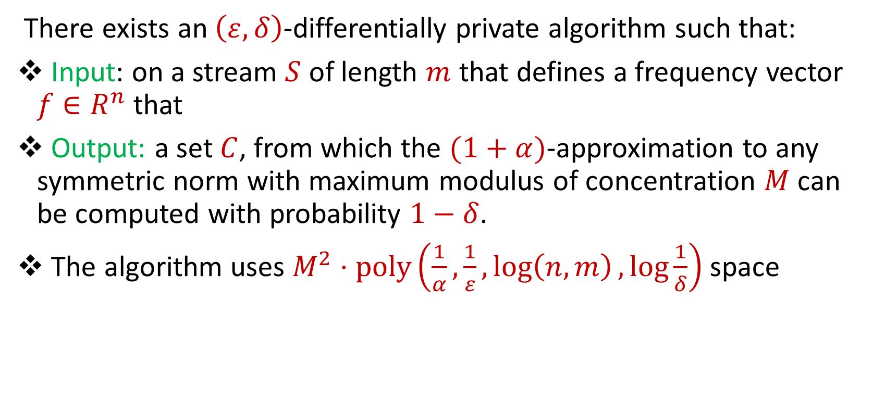
Our Result
There exists an $\left(ε,δ\right)$-differentially private algorithm such that:
Input: on a stream $S$ of length $m$ that defines a frequency vector $f∈R^{n}$ that
Output: a set $C$, from which the $(1+α)$-approximation to any symmetric norm with maximum modulus of concentration $M$ can be computed with probability $1−δ$.
The algorithm uses $M^{2}⋅poly\left(\frac{1}{α},\frac{1}{ε},\log\left(n,m\right),\log{\frac{1}{δ}}\right)$ space
Notes:
However, in our setting, we not only want to output a (1+alpha)-approximation to a symmetric norm query. We want to be able to answer a large number of *PRIVATE* symmetric norm queries without sacrificing accuracy for the large number of private queries. For those familiar with DP, the notion we’ll consider is event-level privacy. Our main result is an algorithm that will output a set C that can answer an arbitrary number of private symmetric norm queries that satisfy some parameterization. Namely, if we give the streaming algorithm roughly M^2 space, then we can achieve an accurate answer to any query that is a symmetric norm with maximum modulus of concentration M.

Slide 10
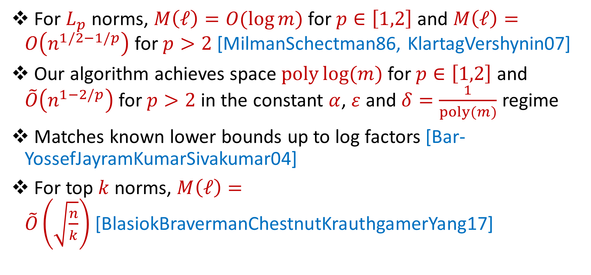
Applications
For $L_{p}$ norms, $M\left(ℓ\right)=O(\log{m)}$for $p∈\left[1,2\right]$ and $M\left(ℓ\right)=O\left(n^{1/2−1/p}\right)$for $p>2$ [MilmanSchectman86, KlartagVershynin07]
Our algorithm achieves space $poly\log{(m)}$for $p∈\left[1,2\right]$ and $\tilde{O}\left(n^{1−2/p}\right)$for $p>2$ in the constant $α$, $ε$ and $δ=\frac{1}{poly(m)}$ regime
Matches known lower bounds up to log factors [Bar-YossefJayramKumarSivakumar04]
For top $k$norms, $M\left(ℓ\right)=\tilde{O}\left(\sqrt{\frac{n}{k}}\right)$[BlasiokBravermanChestnutKrauthgamerYang17]
Notes:
It turns out that for L_p norms, the maximum modulus of concentration M is O(log m) for p in [1,2] and O(n^{1/2-1/p}) for p>2. Our algorithm will thus use polylog(m) space for p in [1,2] and roughly n^{1-2/p} space for p>2, when the accuracy parameter alpha and the privacy loss parameter epsilon are both constant, and the failure probability is inversely polynomial in m. These bounds match known lower bounds up to log factors and are thus near-optimal. Our result also gives a sublinear space algorithm for the class of top-k-norms, which is the sum of the largest k absolute values of the coordinates

Slide 11
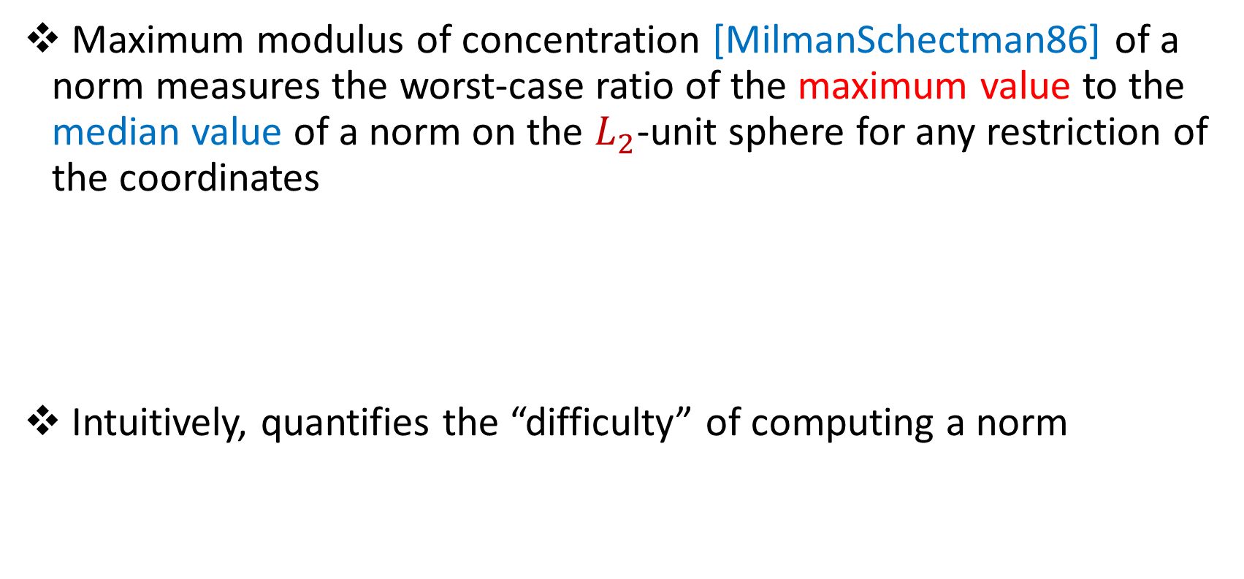
Maximum Modulus of Concentration
Maximum modulus of concentration [MilmanSchectman86] of a norm measures the worst-case ratio of the maximum value to the median value of a norm on the $L_{2}$-unit sphere for any restriction of the coordinates
Intuitively, quantifies the “difficulty” of computing a norm
Notes:
The maximum modulus of concentration M is the worst-case ratio of the maximum value to the median value of a norm, across vectors on the unit L_2 sphere for any restriction of the coordinates and intuitively quantifies the difficulty of computing a norm, so that larger values of M means that the norm requires more space to approximate because the norm is more sensitive to changes in the vector.

Slide 12
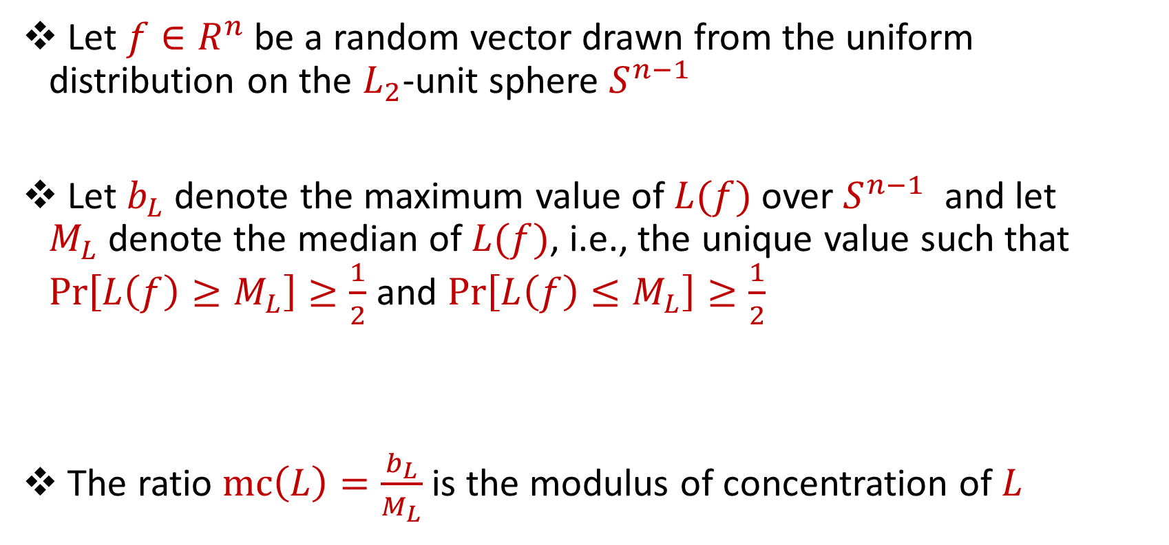
Modulus of Concentration
Let $f∈R^{n}$ be a random vector drawn from the uniform distribution on the $L_{2}$-unit sphere $S^{n−1}$
Let $b_{L}$ denote the maximum value of $L(f)$ over $S^{n−1}$ and let $M_{L}$denote the median of $L(f)$, i.e., the unique value such that $Pr\left[L\left(f\right)≥M_{L}\right]≥\frac{1}{2}$ and $Pr\left[L\left(f\right)≤M_{L}\right]≥\frac{1}{2}$
The ratio $mc\left(L\right)=\frac{b_{L}}{M_{L}}$ is the modulus of concentration of $L$
Notes:
A related quantity is the modulus of concentration, which is ratio of the maximum value to the median value that a norm can take over the unit L_2 sphere

Slide 13
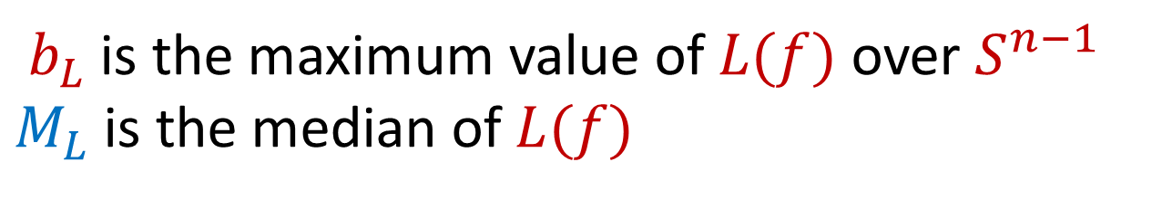
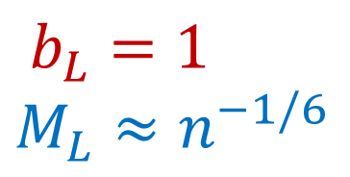
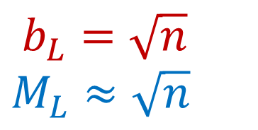
Modulus of Concentration
$b_{L}$ is the maximum value of $L(f)$ over $S^{n−1}$
$M_{L}$is the median of $L(f)$
$b_{L}=\sqrt{n}$
$M_{L}≈\sqrt{n}$
$b_{L}=1$
$M_{L}≈n^{−1/6}$
Notes:
For the L_1 norm on the left, the maximum value an L_2 unit vector can achieve is sqrt(n), when all of the n coordinates have value 1/sqrt(n). The median value of the L_1 norm across the L_2 unit ball is also around sqrt(n). For the L_3 norm in the middle, the maximum value an L_2 unit vector can achieve is 1, when the unit vector is an elementary vector. It turns out that the median value is n^{-1/6}.

Slide 14
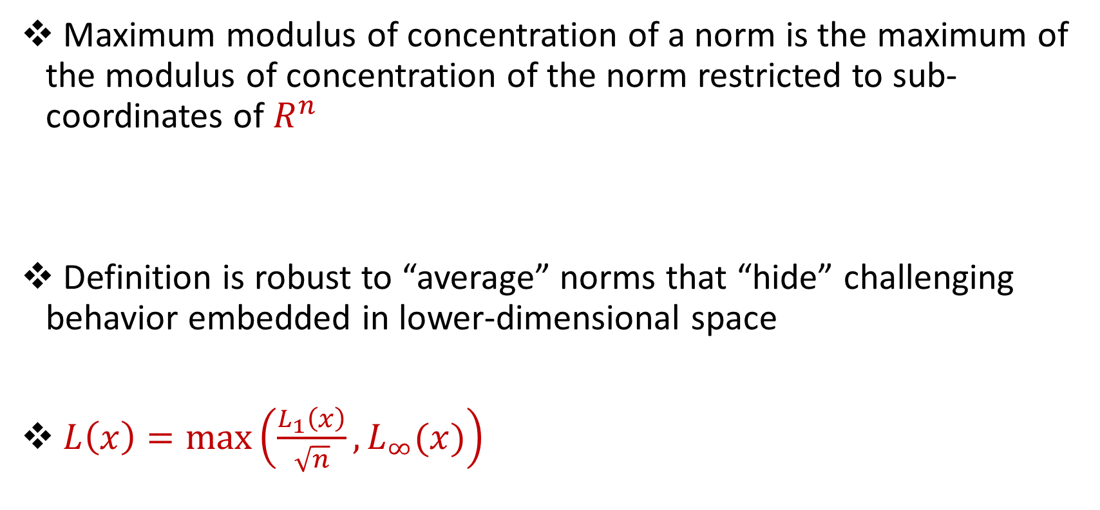
Maximum Modulus of Concentration
Maximum modulus of concentration of a norm is the maximum of the modulus of concentration of the norm restricted to sub-coordinates of $R^{n}$
Definition is robust to “average” norms that “hide” challenging behavior embedded in lower-dimensional space
$L\left(x\right)=\max\left(\frac{L_{1}\left(x\right)}{\sqrt{n}},L_{∞}(x)\right)$
Notes:
The maximum modulus of concentration is the maximum of the modulus of concentration across all sub-coordinate restrictions. This definition captures instances, where a “hard” norm in a lower dimensional space is hidden by an “average” norm in a higher dimensional space. For example, even though L_1 is simple to estimate, L_infty is difficult to estimate in a stream, so this norm L(x) is difficult to estimate and indeed, the definition will show that L(x) has high maximum modulus of concentration

Slide 15
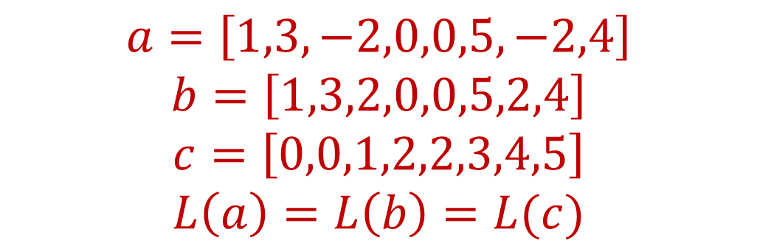
Symmetric Norms
A norm is symmetric if it is invariant under permutations and sign flips on an input frequency vector
$$a=\left[1,3,−2,0,0,5,−2,4\right]$$
$$b=\left[1,3,2,0,0,5,2,4\right]$$
$$c=\left[0,0,1,2,2,3,4,5\right]$$
$$L\left(a\right)=L\left(b\right)=L(c)$$
Notes:
Ok so back to symmetric norms, which are invariant under permutations and sign flips. (THIS SLIDE SHOULD BE REALLY FAST, JUST A REMINDER SLIDE)

Slide 16
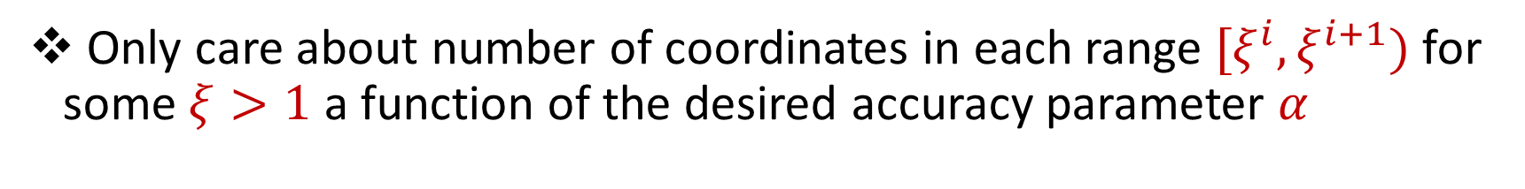
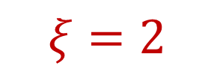
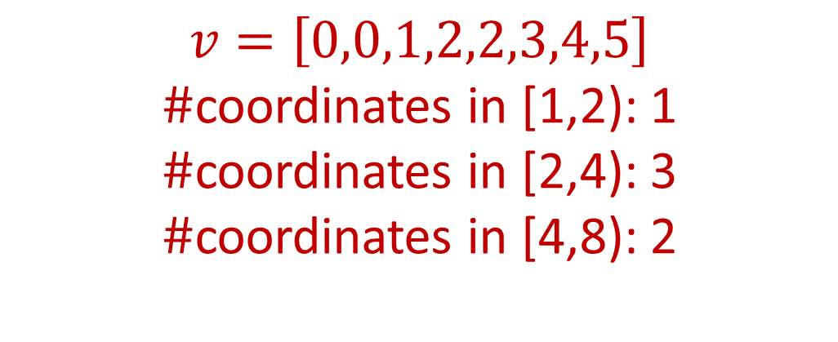
Approximating Symmetric Norms
Only care about number of coordinates in each range $[ξ^{i},ξ^{i+1})$ for some $ξ>1$ a function of the desired accuracy parameter $α$
$$v=\left[0,0,1,2,2,3,4,5\right]$$
$\#$coordinates in [1,2): 1
$\#$coordinates in [2,4): 3
$\#$coordinates in [4,8): 2
$$ξ=2$$
Notes:
Since the norm is symmetric, we can order the coordinates by increasing value and intuitively, we only care about the histogram of the values, that is how many coordinates are of each magnitude. Moreover, if we just want to approximate the norm, then it suffices to determine how many coordinates are in each range of magnitudes. For example, how many coordinates in this vector are between 1 and 2? Between 2 and 4?

Slide 17
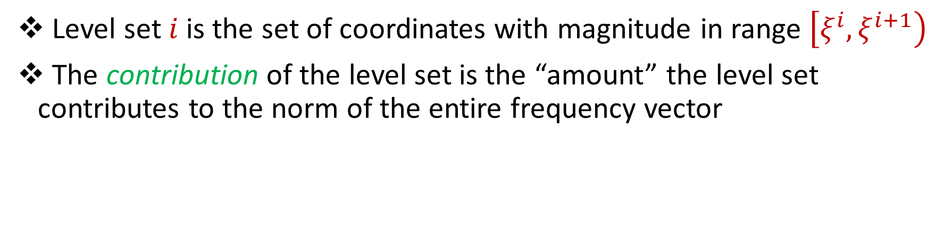
Level Sets and Contribution
Level set $i$is the set of coordinates with magnitude in range $\left[ξ^{i},ξ^{i+1}\right)$
The contribution of the level set is the “amount” the level set contributes to the norm of the entire frequency vector
$$v=\left[0,0,1,2,2,3,4,5\right]$$
Level set 0
Level set 2
Level set 1
Notes:
For a fixed xi>1, we define a level set i to be the set of coordinates with magnitude in range xi^i and xi^{i+1}. For xi=2, the green coordinates are in level set 0, the yellow coordinates are between 2 and 4, and thus in level set 1, and the purple coordinates are between 4 and 8, and thus in level set 2. For a fixed level set, we define the contribution of the level set to be the amount that the level set contributes to the norm of the entire frequency vector

Slide 18
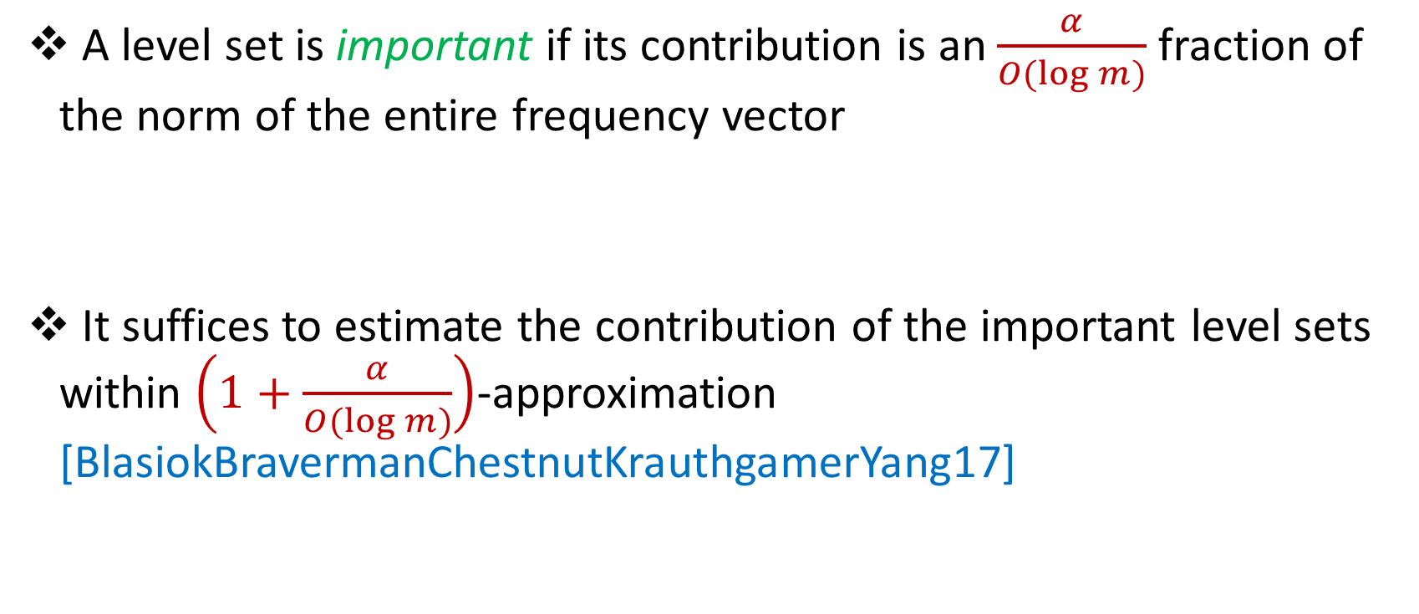
Important Level Sets
A level set is important if its contribution is an $\frac{α}{O(\log{m)}}$fraction of the norm of the entire frequency vector
It suffices to estimate the contribution of the important level sets within $\left(1+\frac{α}{O(\log{m)}}\right)$-approximation [BlasiokBravermanChestnutKrauthgamerYang17]
Notes:
We say a level set is important if its contribution is an alpha/log m fraction of the norm. Recall that we want a (1+alpha)-approximation to the norm. Now if we assume there are at most log m level sets, then even if we zero out all the level sets that are not important, the new vector’s symmetric norm is still within a (1+alpha)-approximation of the original vector. So intuitively, it suffices to achieve a good approximation, i.e., a (1+alpha)-approximation to the important level sets.

Slide 19
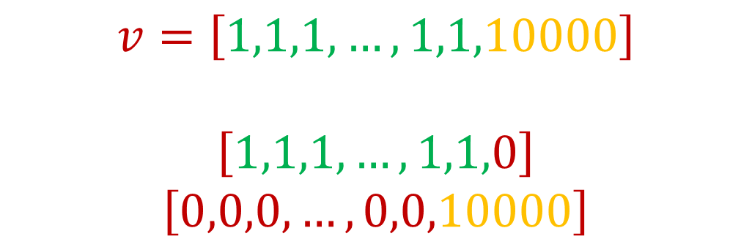
Important Level Sets
Intuition: Important level sets must either have large magnitude coordinates or a large number of coordinates
How to privately release important level sets?
$$v=\left[1,1,1,…,1,1,10000\right]$$
$$\left[1,1,1,…,1,1,0\right]$$
$$\left[0,0,0,…,0,0,10000\right]$$
Notes:
An important level set has large contribution, and it’s helpful to think of two extremes. Either the level set has a single coordinate with large coordinate, or it has a large number of small coordinates, that together contributes a large amount to the norm. For example, vector v has two important level sets. The green level set consists of (n-1) 1’s, thus contributing large mass to the norm. The yellow level set has a single coordinate with large magnitude, thus also contributing large mass to the norm.

Slide 20
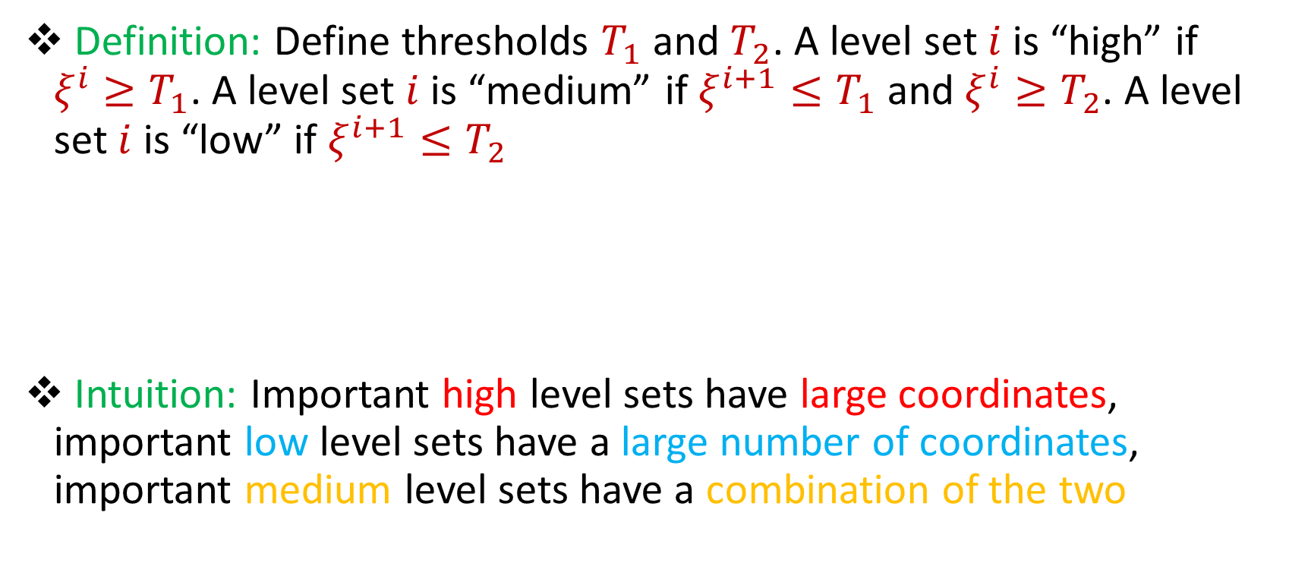
Important Level Sets
Definition: Define thresholds $T_{1}$ and $T_{2}$. A level set $i$is “high” if $ξ^{i}≥T_{1}$. A level set $i$ is “medium” if $ξ^{i+1}≤T_{1}$and $ξ^{i}≥T_{2}$. A level set $i$ is “low” if $ξ^{i+1}≤T_{2}$
Intuition: Important high level sets have large coordinates, important low level sets have a large number of coordinates, important medium level sets have a combination of the two
Notes:
More generally, we define thresholds T1 and T2 and we say a level set is high if the coordinates in the level set have magnitude at least T1. We say a level set is low if the coordinates in the level set have magnitude at most T2. Otherwise the level set is medium. Then from our previous intuition, important high level sets have coordinates with large magnitude, important low level sets have a large number of nonzero coordinates, and important medium level sets have a combination of the two.

Slide 21
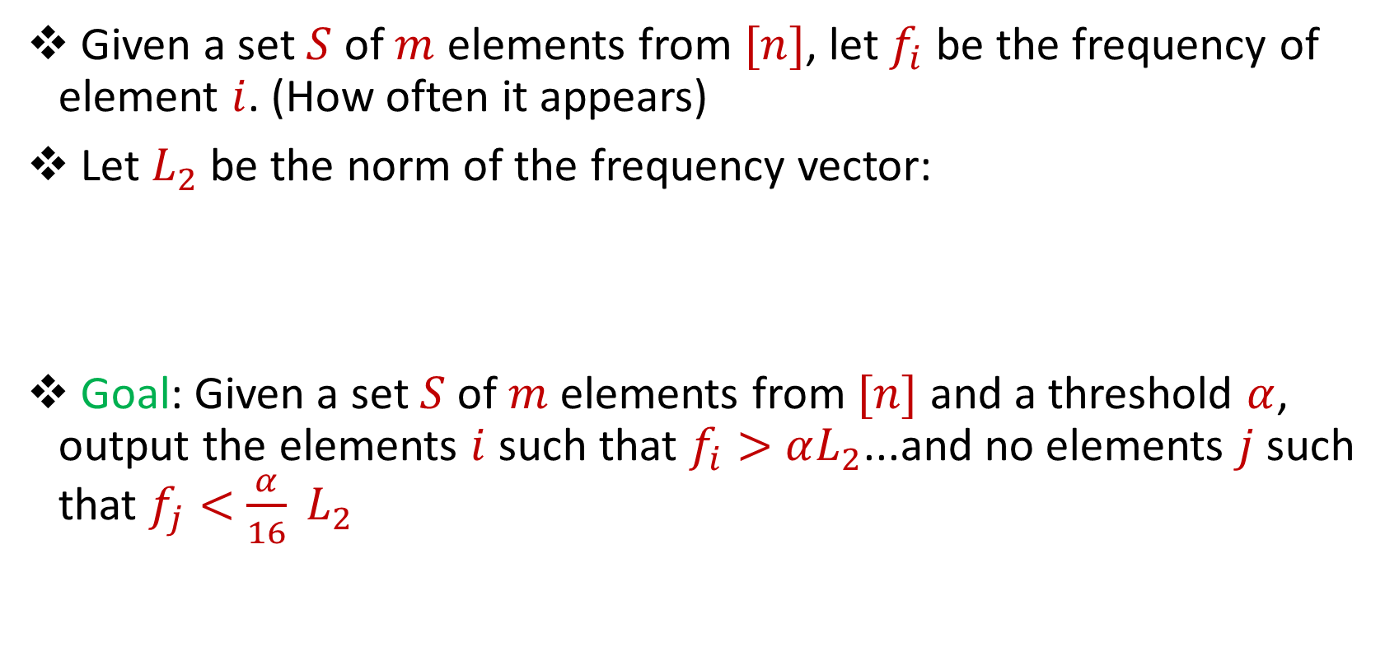
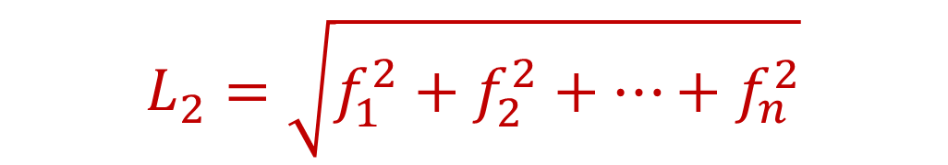
Heavy-Hitters
Given a set $S$ of $m$ elements from $[n]$, let $f_{i}$ be the frequency of element $i$. (How often it appears)
Let $L_{2}$ be the norm of the frequency vector:
Goal: Given a set $S$ of $m$ elements from $[n]$ and a threshold $α$, output the elements $i$ such that $f_{i}>$ $αL_{2}$...and no elements $j$ such that $f_{j}<$ $\frac{α}{16} L_{2}$
$$L_{2}=\sqrt{f_{1}^{2}+f_{2}^{2}+…+f_{n}^{2}}$$
Notes:
An important notion we’ll need is the heavy-hitters of a frequency vector. These are the coordinates of the vector that have magnitude at least an alpha fraction of the overall L_2 norm.

Slide 22
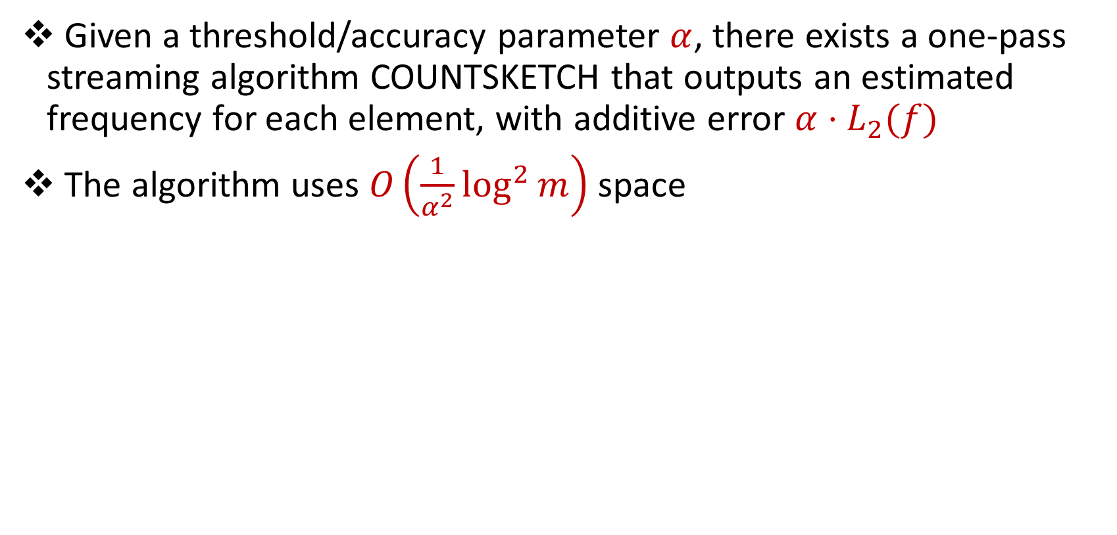
CountSketch
Given a threshold/accuracy parameter $α$, there exists a one-pass streaming algorithm COUNTSKETCH that outputs an estimated frequency for each element, with additive error $α⋅L_{2}(f)$
The algorithm uses $O\left(\frac{1}{α^{2}}\log^{2}{m}\right)$ space
Notes:
There exists a simple algorithm called CountSketch, that allows recovery of the approximate frequencies of the heavy-hitters, using sublinear space. There’s some additive error, but it’s tunable and can be made quite small.

Slide 23
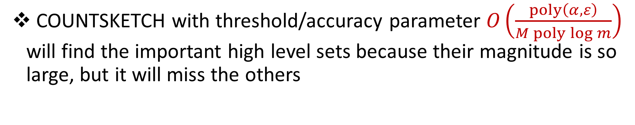

CountSketch
COUNTSKETCH with threshold/accuracy parameter $O\left(\frac{poly\left(α,ε\right)}{M poly\log{m}}\right)$ will find the important high level sets because their magnitude is so large, but it will miss the others
$$v=\left[1,1,1,…,1,1,10000\right]$$
$$\left[1,1,1,…,1,1,0\right]$$
$$\left[0,0,0,…,0,0,10000\right]$$
Notes:
We can aggressively lower the threshold of CountSketch, so it that the algorithm finds the important high levels, because those level sets consist of coordinates with large magnitude. For example, note that a heavy-hitter algorithm with the right threshold will find the large coordinate in this vector, i.e., the yellow level set

Slide 24
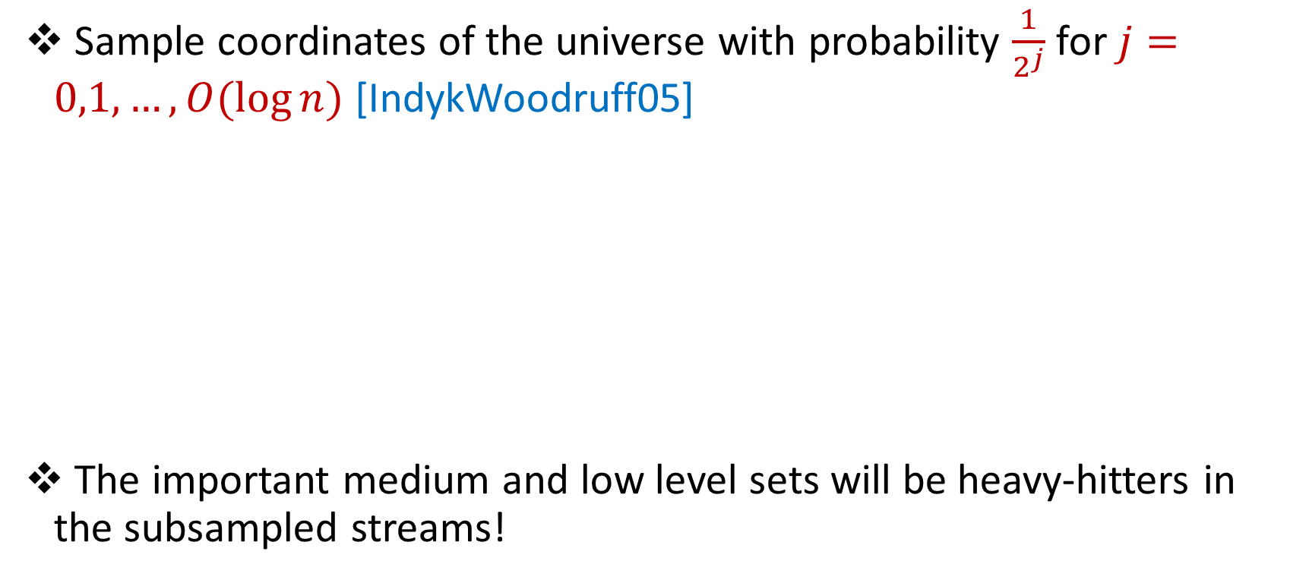
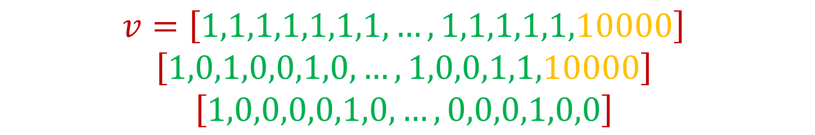
Subsampling the Universe
Sample coordinates of the universe with probability $\frac{1}{2^{j}}$ for $j=0,1,…,O(\log{n)}$ [IndykWoodruff05]
The important medium and low level sets will be heavy-hitters in the subsampled streams!
$$v=\left[1,1,1,1,1,1,1,…,1,1,1,1,1,10000\right]$$
$$\left[1,0,1,0,0,1,0,…,1,0,0,1,1,10000\right]$$
$$\left[1,0,0,0,0,1,0,…,0,0,0,1,0,0\right]$$
Notes:
On the other hand, if we sample coordinates of the universe with probability 1/2^j, then the medium and low level sets will be heavy-hitters in the subsampled streams. For example, consider the vector v. The important low level set, consisting of the coordinates in green, will not be heavy-hitters of the original frequency vector. In fact, even if we subsample about half of the coordinates of the universe, it’s possible we still retain the large coordinate in yellow, so the important low level set coordinates are still not heavy-hitters. However, there are so many of these green coordinates, that at some point when the yellow coordinate is no longer sampled, then the surviving green coordinates will be heavy-hitters.

Slide 25
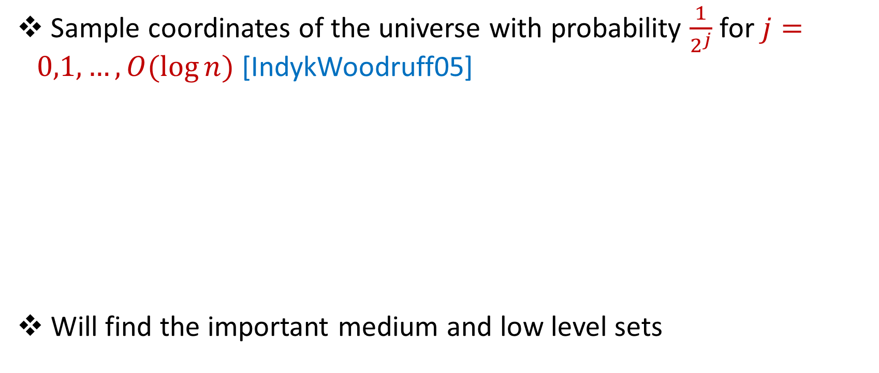
Subsampling the Universe
Sample coordinates of the universe with probability $\frac{1}{2^{j}}$ for $j=0,1,…,O(\log{n)}$ [IndykWoodruff05]
Will find the important medium and low level sets
$$v=\left[1,1,1,1,1,1,1,…,1,1,1,1,1,10000\right]$$
$$\left[1,0,1,0,0,1,0,…,1,0,0,1,1,10000\right]$$
$$\left[1,0,0,0,0,1,0,…,0,0,0,1,0,0\right]$$
Notes:
This approach allows us to find the important medium and low level sets.

Slide 26
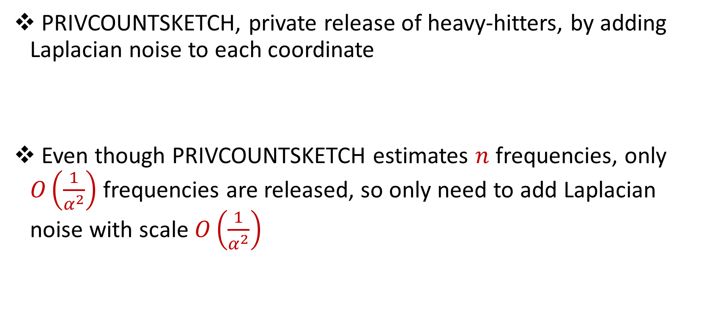
Towards Privacy
PRIVCOUNTSKETCH, private release of heavy-hitters, by adding Laplacian noise to each coordinate
Even though PRIVCOUNTSKETCH estimates $n$ frequencies, only $O\left(\frac{1}{α^{2}}\right)$ frequencies are released, so only need to add Laplacian noise with scale $O\left(\frac{1}{α^{2}}\right)$
Notes:
For the purposes of privacy, we can make CountSketch private by adding noise to the estimated frequencies of the heavy-hitters.

Slide 27
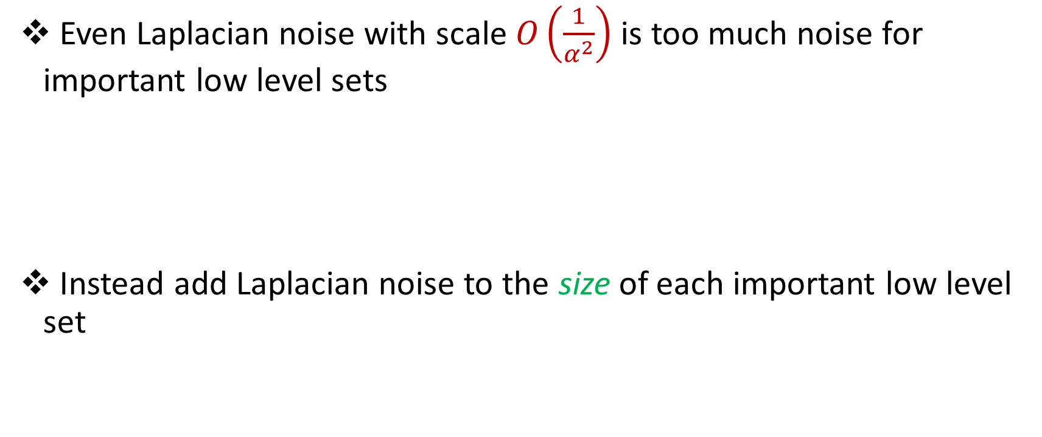
Towards Privacy
Even Laplacian noise with scale $O\left(\frac{1}{α^{2}}\right)$ is too much noise for important low level sets
Instead add Laplacian noise to the size of each important low level set
Notes:
However, it’s important to recall that the important low level sets consist of many instances of small coordinates. These coordinates may be small enough that adding Laplacian noise distorts their contribution by too much. On the other hand, since there are many instances of the small coordinates, it suffices to add Laplacian noise to the size of each important low level set.

Slide 28
Important High Level Sets
PRIVCOUNTSKETCH
Private magnitudes of coordinates
Important Medium Level Sets
Subsampling
PRIVCOUNTSKETCH + Rescaling level set sizes
Private sizes of level sets
Important Low Level Sets
Subsampling
Adding noise to level set sizes
Private sizes of level sets
Notes:
In summary, we handle the important high level sets by a private heavy-hitter algorithm that adds noise to the estimated frequencies of the heavy-hitters. We handle the important medium level sets, by subsampling first and then running private countsketch to get a noisy estimate of the sizes of the level sets. Finally, we handle the important low level sets by subsampling and adding noise to level set sizes, which gives private sizes of the level sets. IF SOMEONE ASKS WHY WE CAN’T JUST ADD NOISE TO THE PRIVATE SIZES OF THE LEVEL SETS OF THE IMPORTANT HIGH LEVEL SETS, THE ANSWER IS THAT THE SIZES OF THE IMPORTANT HIGH LEVEL SETS ARE TOO SMALL (E.G., A SINGLE COORDINATE WITH LARGE MAGNITUDE), SO ADDING NOISE WOULD HEAVILY DISTORT THE CONTRIBUTION.

Slide 29
Additional Challenges
Privately identify coordinates for each level set → Two instances of PRIVCOUNTSKETCH
Classification error for each level set from privacy noise → Thresholds are robust for high, medium, and low important levels
Classification error for each level set from frequency estimation → Randomly choose boundaries of each level set

Slide 30

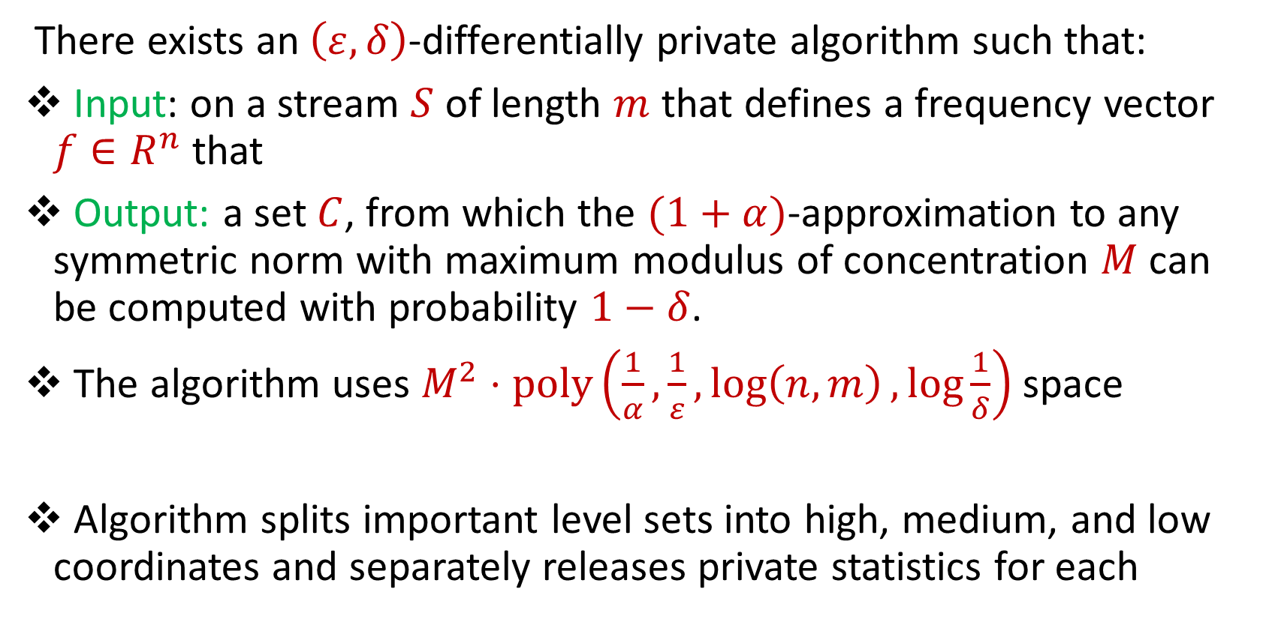
Summary
There exists an $\left(ε,δ\right)$-differentially private algorithm such that:
Input: on a stream $S$ of length $m$ that defines a frequency vector $f∈R^{n}$ that
Output: a set $C$, from which the $(1+α)$-approximation to any symmetric norm with maximum modulus of concentration $M$ can be computed with probability $1−δ$.
The algorithm uses $M^{2}⋅poly\left(\frac{1}{α},\frac{1}{ε},\log\left(n,m\right),\log{\frac{1}{δ}}\right)$ space
Algorithm splits important level sets into high, medium, and low coordinates and separately releases private statistics for each

